Slide 1
Active Object Localization with Deep Reinforcement Learning
Active Object Localization With Deep Reinforcement Learning (thecvf.com)
Squad 4

Slide 2
Table of contents
01
02
03
Introduction
Foundations of Deep Q-Network(DQN)
Modeling the Project
04
Training and testing agent
Squad 4

Slide 3
01
Introduction
Squad 4

Slide 4
01
Introduction
The goal of the project is to develop an active detection model that allows an agent to focus attention on candidate regions to accurately identify the location of a target object. This model is trained using deep reinforcement learning, specifically Deep Q-Network (DQN) algorithms. We will directly apply pre-trained CNN following the architecture of Zeiler and Ferguswith the parameters proposed in the paper and concentrate on using reinforcement learning algorithms to enhance the efficiency of object search and localization.

Slide 5
02
Foundations of Deep Q-Network(DQN)
Squad 4

Slide 6
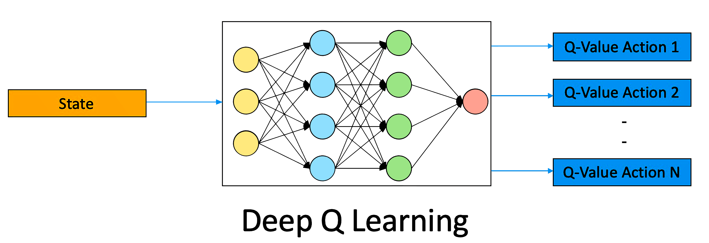
Deep Q-Network(DQN)
DQN is a breakthrough in reinforcement learning, utilizing a deep neural network to approximate the Q-function. This enables the algorithm to handle complex environments and make more accurate predictions.

Slide 7
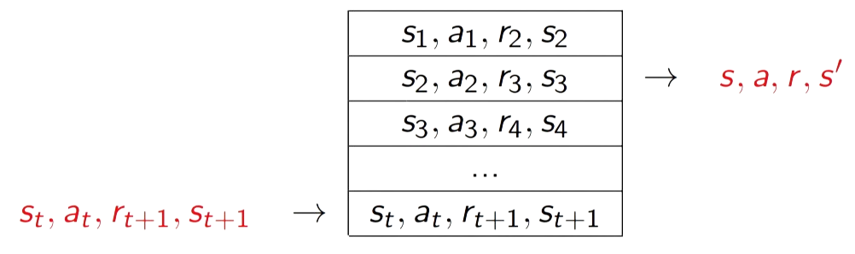
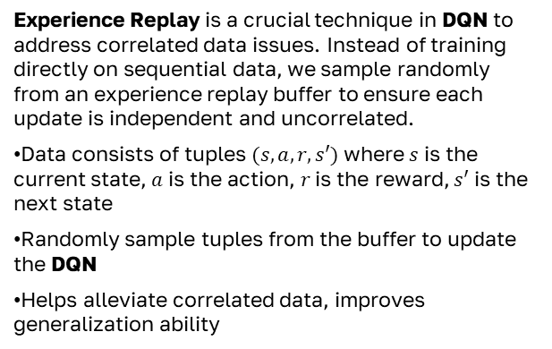
Experience Replay is a crucial technique in DQN to address correlated data issues. Instead of training directly on sequential data, we sample randomly from an experience replay buffer to ensure each update is independent and uncorrelated.
Data consists of tuples $(s,a,r,s′)$ where $s$ is the current state, $a$ is the action, $r$ is the reward, $s′$ is the next state
Randomly sample tuples from the buffer to update the DQN
Helps alleviate correlated data, improves generalization ability

Slide 8
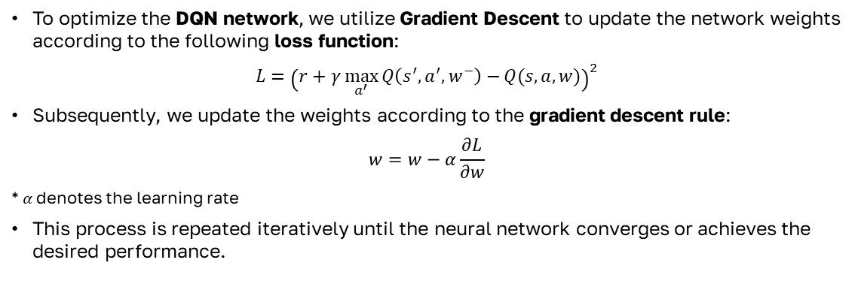
To optimize the DQN network, we utilize Gradient Descent to update the network weights according to the following loss function:
$$L={\left(r+γ\max_{a^{′}}{Q\left(s^{′},a^{′},w^{−}\right)−}Q(s,a,w)\right)}^{2}$$
Subsequently, we update the weights according to the gradient descent rule:
$$w=w−α\frac{∂L}{∂w}$$
* $α$denotes the learning rate
This process is repeated iteratively until the neural network converges or achieves the desired performance.

Slide 9
03
Modeling the Project
Squad 4

Slide 10
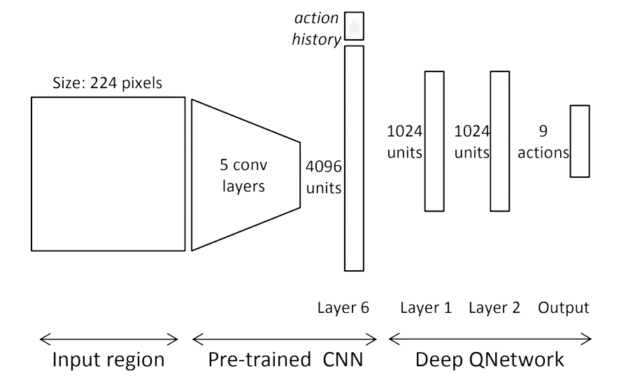
Modeling the Project
States

Slide 11
Modeling the Project
State = feature of the patch(4096) + action history (9x10)

Slide 12
Modeling the Project
Bounding Box

Slide 13
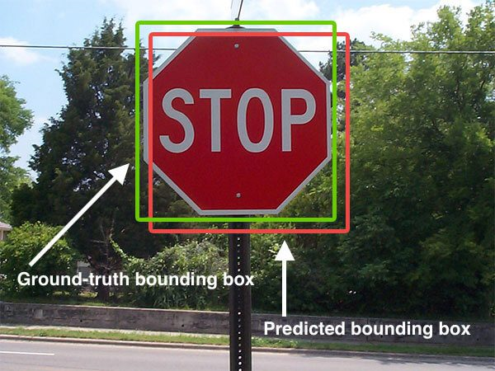
Bounding Box

Slide 14
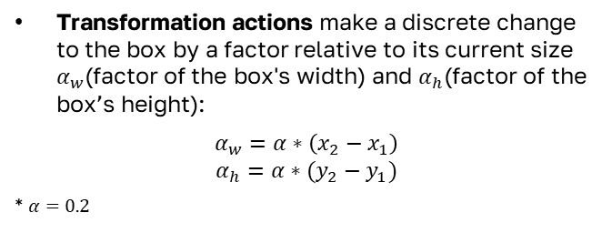
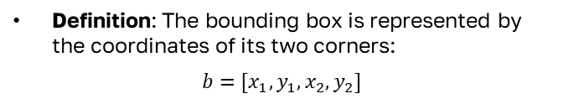
Bounding Box
Definition: The bounding box is represented by the coordinates of its two corners:
$$b=[x_{1},y_{1},x_{2},y_{2}]$$
Transformation actions make a discrete change to the box by a factor relative to its current size $α_{w}$(factor of the box's width) and $α_{h}$(factor of the box’s height):
$$α_{w}=α∗\left(x_{2}−x_{1}\right)$$
$$α_{h}=α∗(y_{2}−y_{1})$$
* $α=0.2$

Slide 15
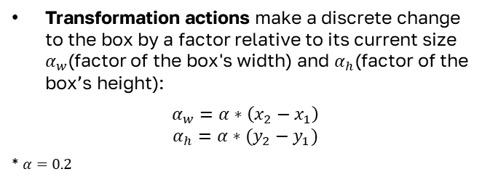
Bounding Box
Definition: The bounding box is represented by the coordinates of its two corners:
$$b=[x_{1},y_{1},x_{2},y_{2}]$$
Transformation actions make a discrete change to the box by a factor relative to its current size $α_{w}$(factor of the box's width) and $α_{h}$(factor of the box’s height):
$$α_{w}=α∗\left(x_{2}−x_{1}\right)$$
$$α_{h}=α∗(y_{2}−y_{1})$$
* $α=0.2$

Slide 16
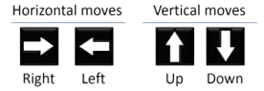
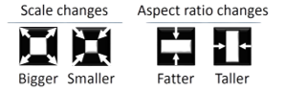

Modeling the Project
Actions

Slide 17
Actions
Horizontal moves:
Right: Move the box horizontally to the right.
Left: Move the box horizontally to the left.
Vertical moves:
Up: Move the box vertically upward.
Down: Move the box vertically downward.

Slide 18
Actions
Scale changes:
Bigger: Increase the size or scale of the box.
Smaller: Decrease the size or scale of the box.
Aspect ratio changes:
Fatter: Increase the width-to-height ratio (decrease the height).
Taller: Decrease the width-to-height ratio (decrease the width).

Slide 19
Actions
Trigger: This terminates the sequence of the current search, and restarts the box in an initial position to begin the search for a new object.

Slide 20
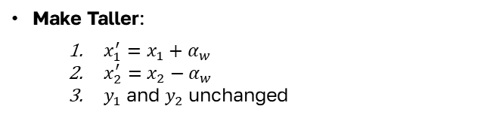
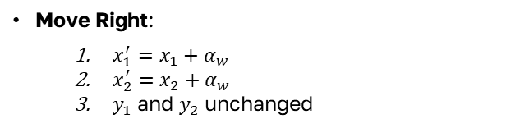
Move Right:
$x_{1}^{′}=x_{1}+α_{w}$
$x_{2}^{′}=x_{2}+α_{w}$
$y_{1}$and $y_{2}$ unchanged
Make Taller:
$x_{1}^{′}=x_{1}+α_{w}$
$x_{2}^{′}=x_{2}−α_{w}$
$y_{1}$and $y_{2}$ unchanged

Slide 21
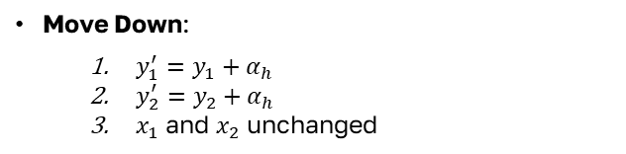
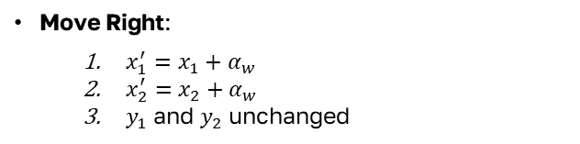
Move Right:
$x_{1}^{′}=x_{1}+α_{w}$
$x_{2}^{′}=x_{2}+α_{w}$
$y_{1}$and $y_{2}$ unchanged
Make Taller:
$x_{1}^{′}=x_{1}+α_{w}$
$x_{2}^{′}=x_{2}−α_{w}$
$y_{1}$and $y_{2}$ unchanged
Move Down:
$y_{1}^{′}=y_{1}+α_{h}$
$y_{2}^{′}=y_{2}+α_{h}$
$x_{1}$and $x_{2}$ unchanged

Slide 22
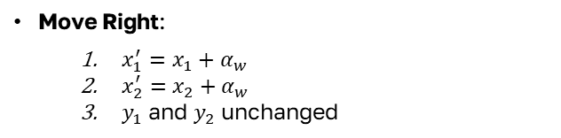
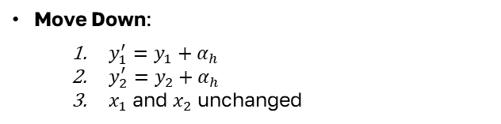
Move Right:
$x_{1}^{′}=x_{1}+α_{w}$
$x_{2}^{′}=x_{2}+α_{w}$
$y_{1}$and $y_{2}$ unchanged
Make Taller:
$x_{1}^{′}=x_{1}+α_{w}$
$x_{2}^{′}=x_{2}−α_{w}$
$y_{1}$and $y_{2}$ unchanged
Move Down:
$y_{1}^{′}=y_{1}+α_{h}$
$y_{2}^{′}=y_{2}+α_{h}$
$x_{1}$and $x_{2}$ unchanged

Slide 23
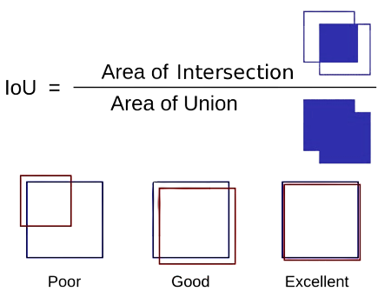
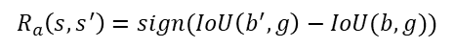
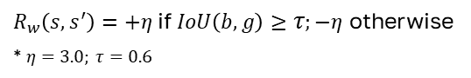
Modeling the Project
Rewards
$$R_{a}\left(s,s^{′}\right)=sign(IoU\left(b^{′},g\right)−IoU(b,g))$$
$R_{w}\left(s,s^{′}\right)=+η$ if $IoU\left(b,g\right)≥τ;−η$ otherwise
* $η=3.0; τ=0.6$

Slide 24
04
Training and testing agent
Squad 4

Slide 25
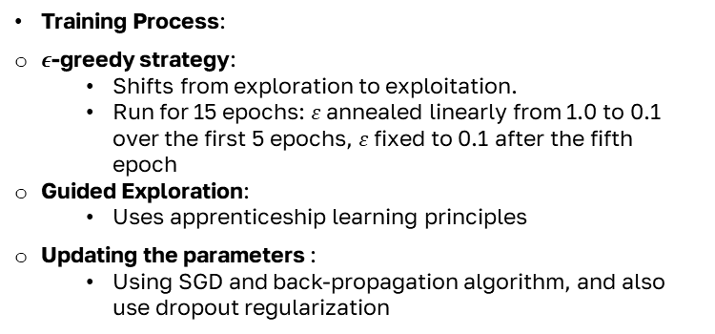
Training
Initialization:
Q-network parameters initialized randomly
Training Process:
$ε$-greedy strategy:
Shifts from exploration to exploitation.
Run for 15 epochs: 𝜀 annealed linearly from 1.0 to 0.1 over the first 5 epochs, 𝜀 fixed to 0.1 after the fifth epoch
Guided Exploration:
Uses apprenticeship learning principles
Updating the parameters :
Using SGD and back-propagation algorithm, and also use dropout regularization

Slide 26
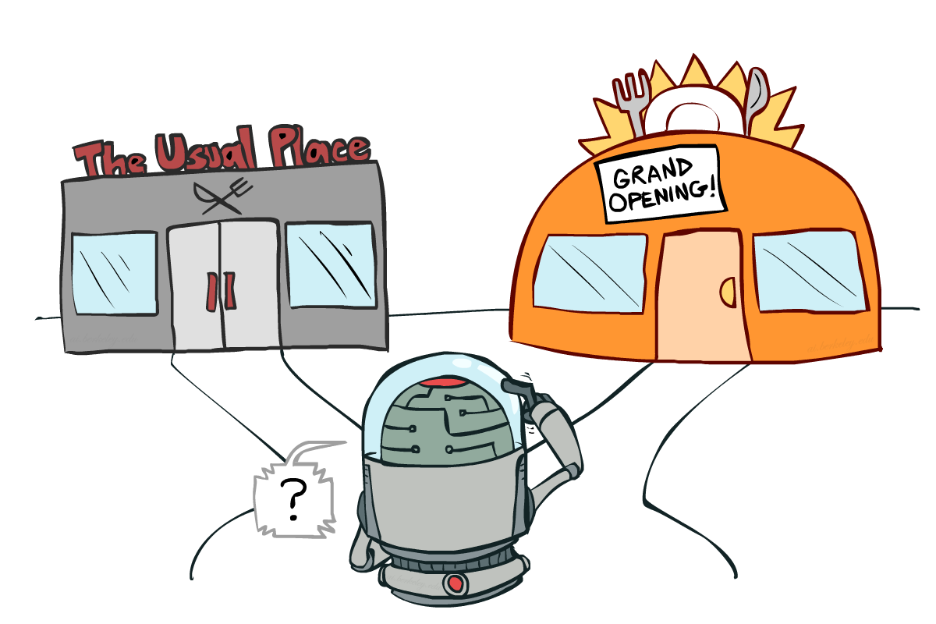
Training
Initialization:
Q-network parameters initialized randomly
Training Process:
$ε$-greedy strategy:
Shifts from exploration to exploitation.
Run for 15 epochs: 𝜀 annealed linearly from 1.0 to 0.1 over the first 5 epochs, 𝜀 fixed to 0.1 after the fifth epoch
Guided Exploration:
Uses apprenticeship learning principles
Updating the parameters :
Using SGD and back-propagation algorithm, and also use dropout regularization

Slide 27
Testing
Maximum Steps: Agent runs for a maximum of 200 steps per test image.
Decision Making:
At each step, the agent decides to either transform the current box or trigger indication of object found.
When the trigger is used, the search for other objects continues from a new box covering a large portion of the image.
Restart Strategy:
Search for objects is restarted under two conditions:
The agent uses the trigger.
40 steps pass without using the trigger.
Box Resetting:
The very first box covers the entire scene.
After any restarting event, the new box has a reduced size (75% of image size).
The new box is placed in one of the four corners of the image in the same order (from top-left to right-bottom).

Slide 28
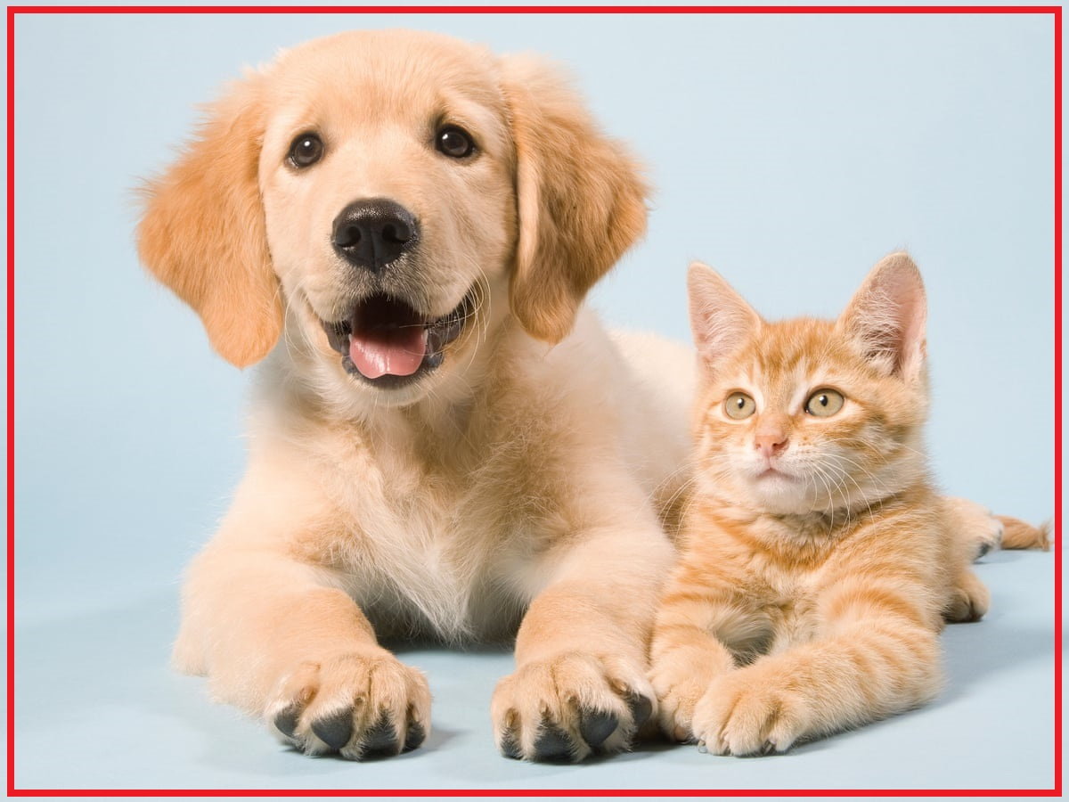
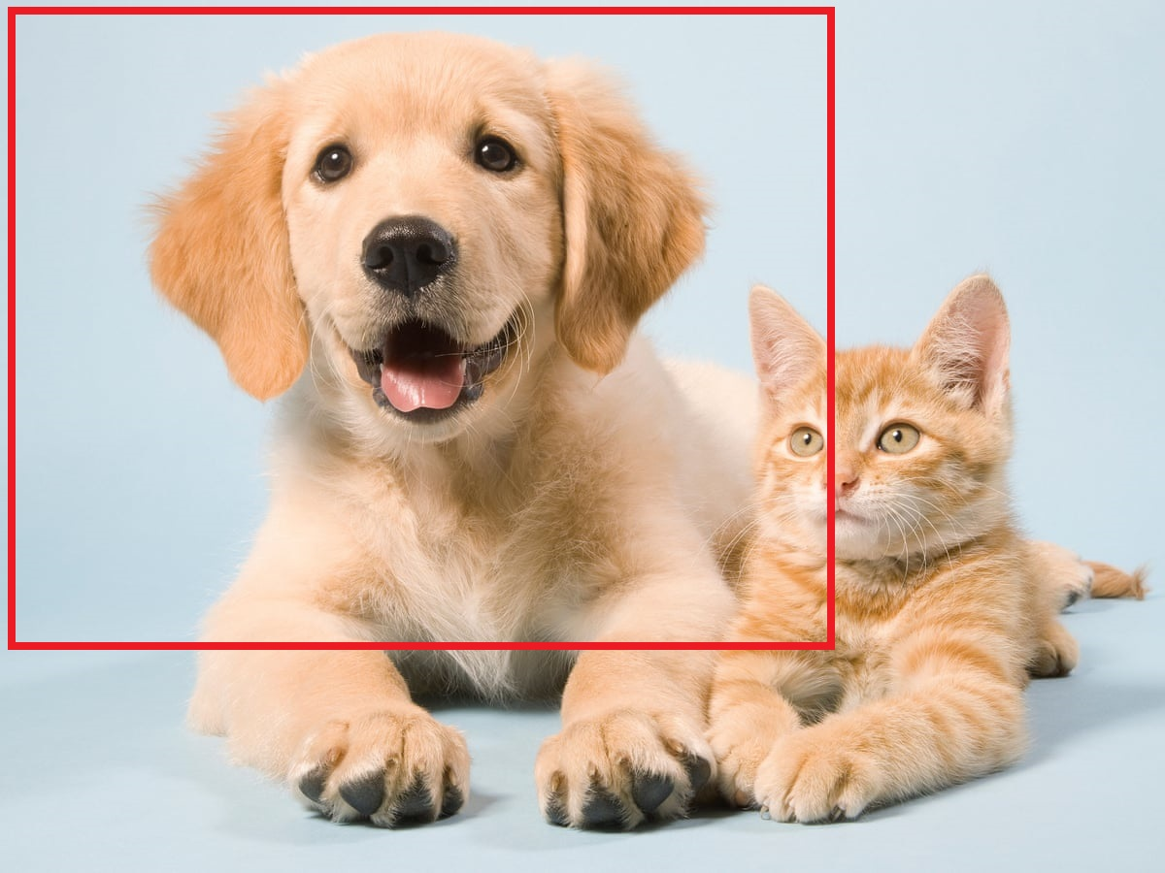
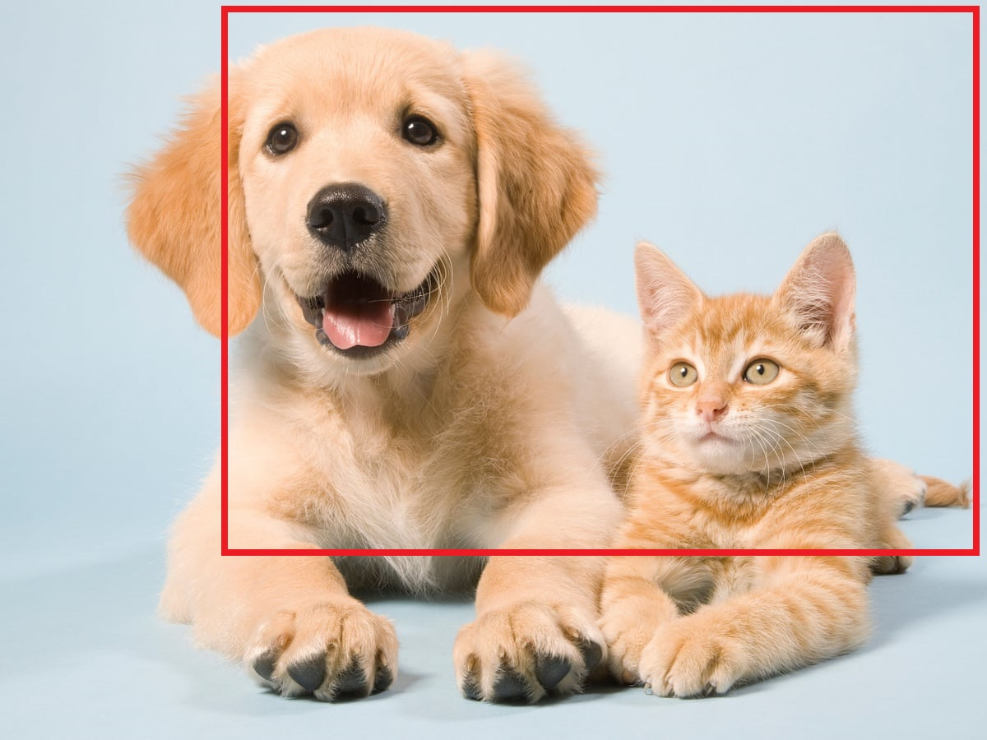
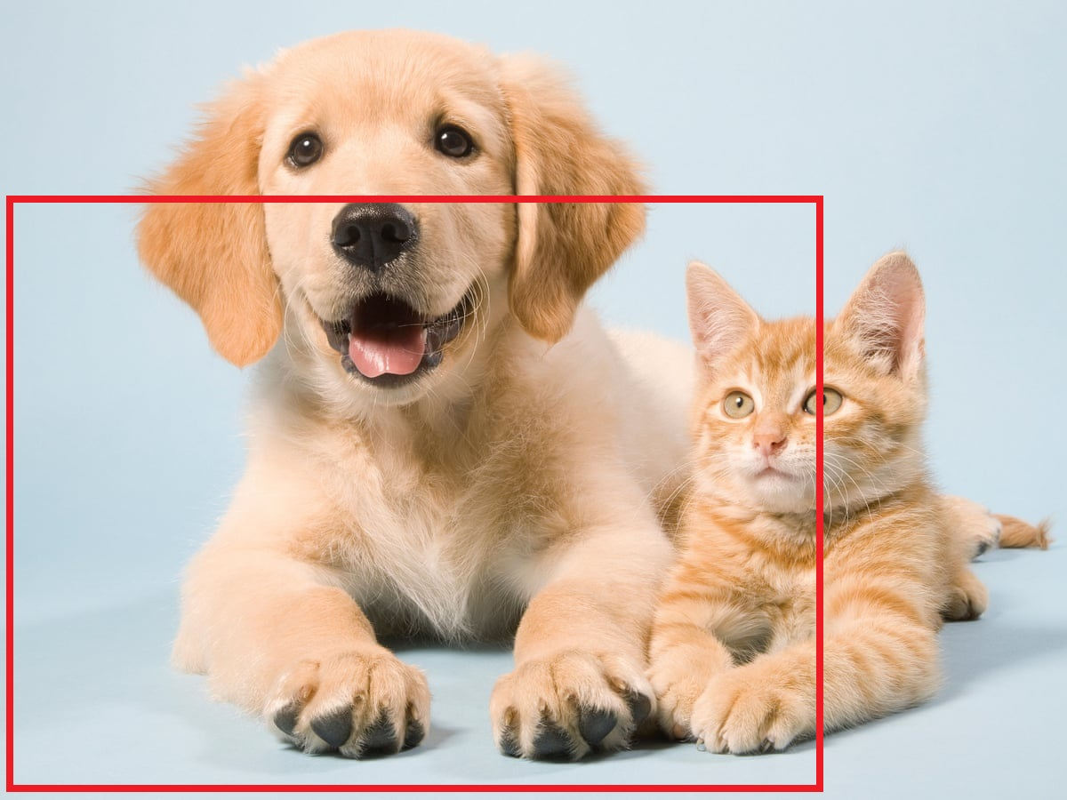
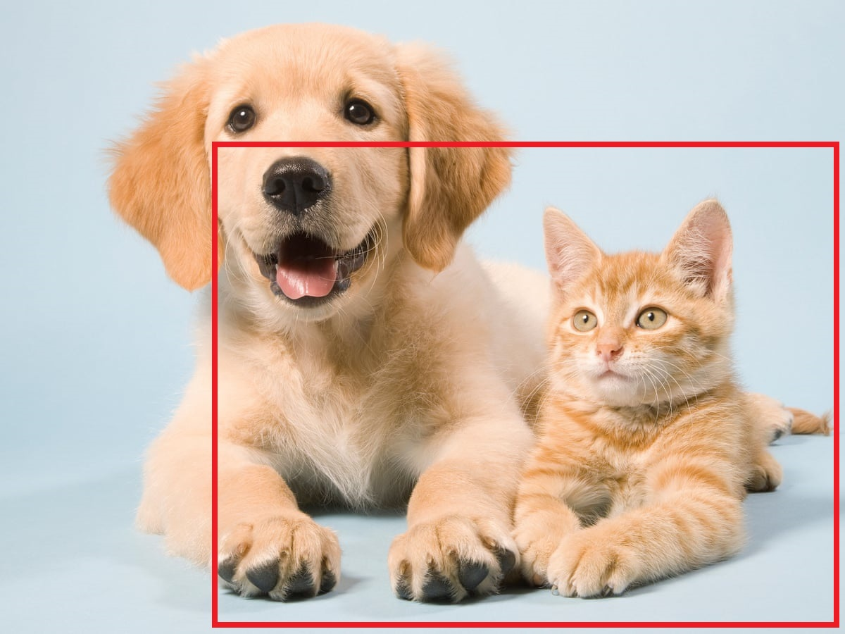
Testing
Maximum Steps: Agent runs for a maximum of 200 steps per test image.
Decision Making:
At each step, the agent decides to either transform the current box or trigger indication of object found.
When the trigger is used, the search for other objects continues from a new box covering a large portion of the image.
Restart Strategy:
Search for objects is restarted under two conditions:
The agent uses the trigger.
40 steps pass without using the trigger.
Box Resetting:
The very first box covers the entire scene.
After any restarting event, the new box has a reduced size (75% of image size).
The new box is placed in one of the four corners of the image in the same order (from top-left to right-bottom).

